Slide 1

Lecture 2
Number System

Slide 2
Previous Class Summary
Analog Signals
  Time-varying signals
  Take any value across a continuous range of voltage, current or whatever metric
Digital Signals
  Digital electronics represents information as a finite set of values.
  If there are 2 levels we call this binary information

Slide 3
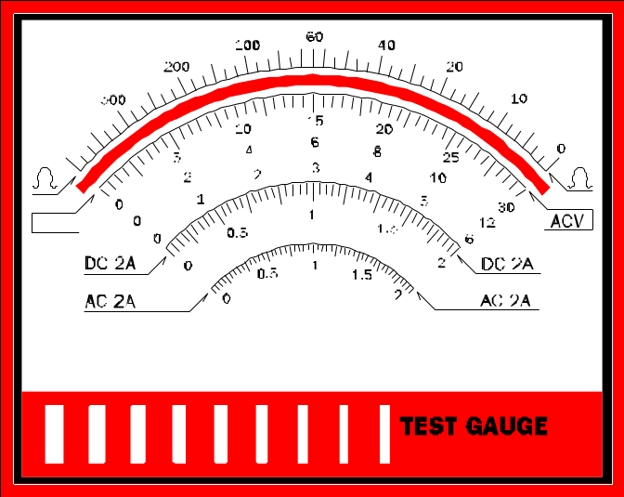
Analog versus Digital
Analog Voltage meter
Digital Voltage meter
103.5
About 100

Slide 4



Analog has Ambiguity
Digital has only one interpretation
Analog Clock
Digital Clock
1:56 pm
1:56
About 2:00
1:56
1:50

Slide 5
Number Systems
To talk about binary data, we must first talk about number systems
The decimal number system (base 10) you should be familiar with!
Positional number system

Slide 6
Positional Notation
Value of number is determined by multiplying each digit by a weight and then summing. The weight of each digit is a POWER of the BASE and is determined by position.

Slide 7
Example 1
A Decimal Number such as 1234
represent a quantity equal to one thousand
Plus two hundred
Plus 3 tens
Plus 4 units

Slide 8
Thousands, hundreds etc are the powers of 10 implied by the position of the coefficients
To be more exact 1234 should be written as
1 * 10³ + 2 * 10² + 3 * 10¹ + 4 * 10⁰
In general, a number with decimal point is represented by a series of coefficients as follows
……..a₅a₄a₃a₂a₁a₀ . a₋₁a₋₂a_{-3…….}
The coefficient a_{j} are one of the ten digits (0-9)
the subscript value j give the place value and hence power of 10 by which the coefficient must be multiplied.

Slide 9
The decimal number system (base 10) you should be familiar with!
  A digit in base 10 ranges from 0 to 9.
  A digit in base 2 ranges from 0 to 1 (binary number system). A digit in base 2 is also called a ‘bit’.
  A digit in base R can range from 0 to R-1
  A digit in Base 16 can range from 0 to 16-1 (0,1,2,3,4,5,6,7,8,9,A,B,C,D,E,F). Use letters A-F to represent values 10 to 15. Base 16 is also called Hexadecimal or just ‘Hex’.

Slide 10
Base 10, Base 2, Base 16
953.78₁₀ = 9 x 10² + 5 x 10¹ + 3 x 10⁰ + 7 x 10⁻¹ + 8 x 10⁻²
= 900 + 50 + 3 + .7 + .08 = 953.78
1011.11₂ = 1x2³ + 0x2² + 1x2¹ + 1x2⁰ + 1x2⁻¹ + 1x2⁻²
= 8 + 0 + 2 + 1 + 0.5 + 0.25
= 11.75
A2F₁₆ = 10x16² + 2x16¹ + 15x16⁰
= 10 x 256 + 2 x 16 + 15 x 1
= 2560 + 32 + 15 = 2607

Slide 11
Conversion of Any Base to Decimal
Converting from ANY base to decimal is done by multiplying each digit by its weight and summing.
Binary to Decimal
1011.11₂ = 1x2³ + 0x2² + 1x2¹ + 1x2⁰ + 1x2⁻¹ + 1x2⁻²
= 8 + 0 + 2 + 1 + 0.5 + 0.25
= 11.75
Hex to Decimal
A2F₁₆ = 10x16² + 2x16¹ + 15x16⁰
= 10 x 256 + 2 x 16 + 15 x 1
= 2560 + 32 + 15 = 2607

Slide 12
Conversion of Decimal Integer To ANY Base
Divide Number N by base R until quotient is 0.
Remainder at EACH step is a digit in base R, from Least Significant digit to Most significant digit.

Slide 13
Conversion of Decimal Integer To ANY Base
Example
Convert 53 to binary
Least Significant Digit
53/2 = 26, rem = 1
26/2 = 13, rem = 0
13/2 = 6 , rem = 1
6 /2 = 3, rem = 0
3/2 = 1, rem = 1
1/2 = 0, rem = 1
53₁₀ = 110101₂
= 1x2⁵ + 1x2⁴ + 0x2³ + 1x2² + 0x2¹ + 1x2⁰
= 32 + 16 + 0 + 4 + 0 + 1 = 53
Most Significant Digit

Slide 14
Conversion of Decimal fraction To ANY Base
Example
Decimal fraction to Binary
    It is accomplished by a method similar to that used for integers.
    Multiplication is used instead of division
    Integers are accumulated instead of remainders

Slide 15
Example 1
Convert (0.6875)₁₀ into binary
Integer Fraction Coefficient
0.6875 * 2 = 1 + 0.3750 a₋₁= 1
0.3750 * 2 = 0 + 0.7500 a₋₂= 0
0.7500 * 2 = 1 + 0.5000 a₋₃= 1
0.5000 * 2 = 1 + 0.0000 a₋₄= 1
Answer: (0.6875)₁₀ = ( 0.a₋₁a₋₂a₋₃a₋₄)₂= (0.1011)₂

Slide 16
To Convert a decimal fraction to a number expressed in base r , a similar procedure is used.
Multiplication by r instead of 2
The coefficient found from the integers may range in values from 0 to r-1 instead of 0 and 1.

Slide 17
Example 2
Convert (0.513)₁₀ into octal
Integer Fraction Coefficient
0.513 * 8 = 4 + 0.104 a₋₁= 4
0.104 * 8 = 0 + 0.832 a₋₂= 0
0.832 * 8 = 6 + 0.656 a₋₃= 6
0.656 * 8 = 5 + 0.248 a₋₄= 5
0.248 * 8 = 1 + 0.984 a₋₄= 1
0.984 * 8 = 7 + 0.872 a₋₄= 7
Answer: (0.513)₁₀ = ( 0.a₋₁a₋₂a₋₃a₋₄a₋₅a₋₆….) ₈ = ( 0.406517……)₈

Slide 18
Direct conversion from binary to octal
Binary numbers can be converted into equivalent octal numbers by making groups of three bits starting from LSB and moving towards MSB for integer part of the number
Then replacing each group of three bits by its octal representation.
For fractional part, the groupings of three bits are made starting from the binary point.
If last group does not have 3 bits, then pad with zeros

Slide 19
Octal equivalent of 3 bit binary Number
Octal Digits to binary:
0₈ = 000₂
1₈ = 001₂
2₈ = 010₂
3₈ = 011₂
4₈ = 100₂
5₈ = 101₂
6₈ = 110₂
7₈ = 111₂

Slide 20
Example:
Convert (011001110001)₂ into octal
Form the group of 3 bits starting from LSB and moving towards MSB
011 001 110 001
Write the octal equivalent of group of 3 bit binary number at their respective places
3 1 6 1
(011001110001)₂ = ( 3161 )₈

Slide 21
Example:
Convert (1001110001.100)₂ into octal
Grouping of 3-bits (LSB To MSB) for integer part
from binary point for fractional part
001 001 110 001 . 100
Padded with a zeros
Write the octal equivalent of group of 3 bit binary number at their respective places
1 1 6 1 . 4
( 001 001 110 001 . 100 )₂ = ( 1 1 6 1 . 4 )₈

Slide 22
Direct conversion from binary to Hexa decimal(Hex)
Binary numbers can be converted into equivalent Hex numbers by making groups of four bits starting from LSB and moving towards MSB for integer part of the number
Then replacing each group of four bits by its Hex representation.
For fractional part, the groupings of four bits are made starting from the binary point.
If last group does not have 4 bits, then pad with zeros

Slide 23
Hex equivalent of 4 bit binary Number
Hex Digits to binary:
0₁₆ = 0000₂
1₁₆ = 0001₂
2₁₆ = 0010₂
3₁₆ = 0011₂
4₁₆ = 0100₂
5₁₆ = 0101₂
6₁₆ = 0110₂
7₁₆ = 0111₂
8₁₆ = 1000₂
Hex Digits to binary (cont):
9₁₆ = 1001₂
A₁₆ = 1010₂
B₁₆ = 1011₂
C₁₆ = 1100₂
D₁₆ = 1101₂
E₁₆ = 1110₂
F₁₆ = 1111₂

